Slide 1
That's not a noun?
Learning verbs that are nouns
Nouns with different meaning in plural form
Introduction to Adjectives

Slide 2
Can a word be both a noun and a verb?
When you begin to learn grammar, it is common to start with two of the most common parts of speech: nouns and verbs.
Getting the hang of the difference between these two parts of speech puts you on the right track to mastering English.
Nouns name things. Many times, you will hear people define nouns as persons, places or things. But they can also name feelings, ideas and acts.

Slide 3
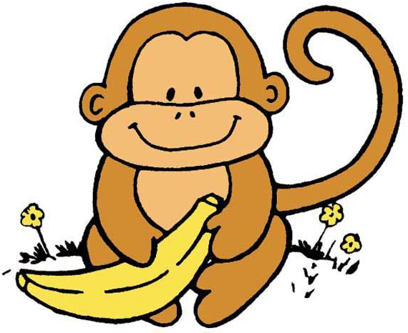
nouns and verbs
A noun that names one thing is singular. A noun that names more than one thing is plural. Example: Monkey (singular) – Monkeys (plural)
Verbs describe action. We use verbs in sentences to describe what the nouns do.
Peel, eat and love are all verbs in these sentences.
Monkeys peel bananas.
Monkeys eat bananas.
Monkeys love bananas.

Slide 4
A word can be both a noun and a verb
There are many words that can be used to name a person, place or thing and also describe an action.
For example: Monkeys love bananas.
love – is a verb in this sentence,
but love is also a noun.

Slide 5
nouns?
There are many, many more examples of words that can be both nouns and verbs.
Here are a few that you will probably become familiar with:
act | back | cake | number
balloon | address | bank | drive
cook | flower | answer | face
drink | color | deal | bear
email | help | guide | jump

Slide 6
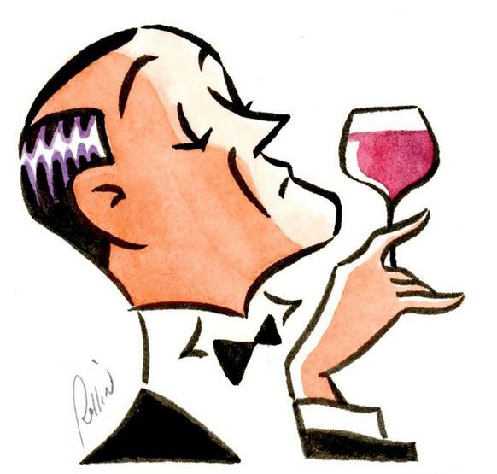
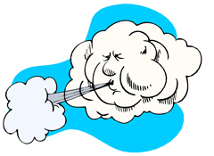
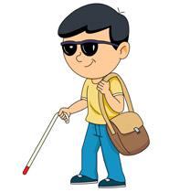

Nouns with different meanings in plural form
Some nouns have different meanings in the singular and the plural. Examples are given below:
air | atmosphere
airs | affected manners
blind | unable to see
blinds | protective covering to keep out light and for privacy

Slide 7
Introduction to adjectives
Adjectives are words use to describe or modify a noun.
Adjectives never change.
They are never plural.
Adjectives go before their nouns.
Example:
This is a nice monkey.
The monkey loves fresh bananas.

Slide 8
Noun or verb or adjective?
Some words can be all three!
For example the word yellow:
The monkey ate a big yellow banana. Adjective
The banana has hues of yellow. Noun
The banana was green at first, but now it’s
beginning to yellow. Verb

Slide 9
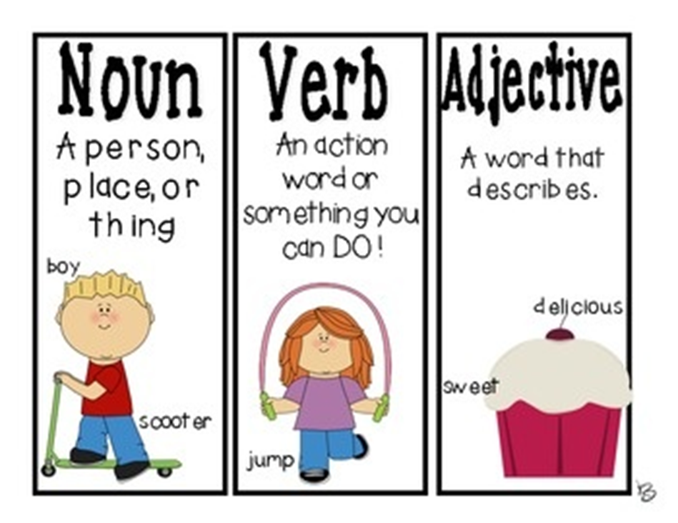
Remember!
Nouns, Verbs and Adjectives are 3 different parts of speech.
No matter if it is the same word, such as yellow:

